Slide 1
SQAS 2022
To replace the background image:
1/Go to Slide Master (Menu “View”)
2/Right-click on the image
3/Select “Replace image…”
4/Close the Slide Master
ECTA Workshop
7 October 2021

Slide 2
What is new in SQAS 2022 questionnaires?
Measuring and managing of GHG emissions
Prevention of plastic pellets loss
Digitalization

Slide 3
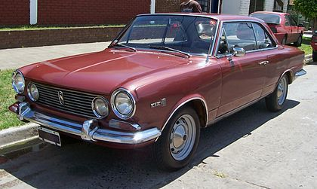
Global warming: where the problem is coming from…
Torino coupe produced by Renault Argentina between 1966 and 1981
“Argentinian” car but designed by Italian “Carrozzeria Pininfarina”
Winner of the “84 Horas of Nürburgring” in Germany in 1969
Bought in 1986
Engine 200 hp at 4500 rpm
Consumption of 12 litres /100 km !!

Slide 4
How serious global warming is?
Intergovernmental Panel on Climate Change (IPCC) report of 7 August 2021
+1,5 ºC is possible if zero emissions are achieved by 2050
5 possible scenarios in temperature increase by 2100: + 1.9 ºC , + 2.6 ºC, +4.5 ºC, + 7.0 ºC, + 8.5 ºC
“The IPCC report is unequivocal that past emissions of greenhouse gases have led to the unprecedented rates of climate change (including heatwaves and intense rainfall) that we are seeing around the world today. It further details how we are already locked into centuries of sea-level rise and that each tonne of greenhouse gases we emit will further increase climate-related hazards around the world”
Piers Forster, IPCC coordinating lead author and member of the Climate Change Committee

Slide 5
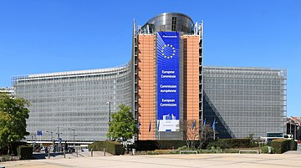
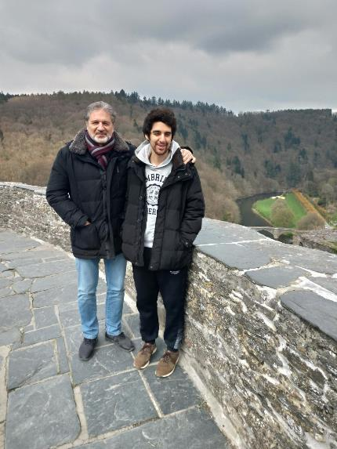
Fight against global warming: this is all about motivation …
Elon Musk: in 2004 he bought Tesla, the electric vehicle manufacturing company
Sustainable and Smart Mobility Strategy published by the European Commission in Dec 2020
Objective:
90% reduction in greenhouse gas emissions in transport by 2050

Slide 6
GHG emissions and management in SQAS 2022 questionnaires : a short story
Interviews with 5 transport European companies (big and middle size) to know how they measure GHG emissions and to learn about their approach to emission reduction programmes
20 meetings of the SQAS T&A Committee during the 1st semester 2021: 3 hours/meeting x 10 attendees/meeting = 600 hours. Most of the time discussing about GHG emissions, the rest of the time discussing OCS requirements and digitalization

Slide 7
New GHG emission sections in SQAS 2022 questionnaires:
New GHG emissions sections were created in SQAS 2022 Transport Service, Tank Cleaning and Warehouse questionnaires
Main objective is to standardize the method used to measure GHG emissions. Second objective: managing of emissions
“Hierarchy principle” in the developing of questions: higher accuracy in the calculation method will end up in higher scores
Based on the GLEC framework methodology of measuring emissions issued by Smart Freight Centre (SFC): https://www.smartfreightcentre.org/en/how-to-implement-items/what-is-glec-framework/58/
Current section of SQAS 2019 Transport Service questionnaire has 10 questions related to GHG emission. SQAS 2022 has 28 questions

Slide 8
New GHG emission section in SQAS 2022 Transport Service questionnaire
Emission measurement of own vehicles (Scope 1 and 2)
Emission measurement of subcontracted vehicles (Scope 3)
FIS (Fully Integrated Subcontractors) and NIS (Non-Integrated Subcontractors)
Intermodal
Tank Cleaning
Subcontracted Warehouse
Consolidating and reporting emissions
Training
Reducing emissions
Strategy
Objectives (should be aligned with 90% emission reduction objective of the Sustainable and Smart Mobility Strategy from EU)
Programme
Examples of calculations of GHG emissions will be uploaded into the SQAS website

Slide 9
New GHG emission section in SQAS 2022 Tank Cleaning questionnaire
Measuring emissions
From boilers, steam generators and incinerators/flares (scope 1)
From electricity to move high pressure pumps and lighting (scope 2)
To heat loaded containers (scope 1 or 2)
Reducing emissions
Strategy
Objectives (should be aligned with 90% emission reduction objective of the Sustainable and Smart Mobility Strategy from EU)
Programme

Slide 10
New GHG emission section in SQAS 2022 Warehouse questionnaire
Basis: “Guide for Greenhouse Gas Emissions Accounting for Logistic Sites” issued by the Fraunhofer Institute for Material Flow and Logistics (Jan 2019)
Measuring emissions
From forklifts running with fuel /gas (scope 1)
From electric forklifts, temperature-controlled chambers (refrigerated and heated), lighting, conveyors, wrapping machines and packing/repacking devices (scope 2)
Reducing emissions
Strategy
Objectives (should be aligned with 90% emission reduction objective of the Sustainable and Smart Mobility Strategy from EU)
Programme

Slide 11
New questions related to prevention of pellets loss
Aligned with OCS (Operation Clean Sweep) from Plastics Europe and European Plastic Converters associations
Number of questions by type of assessment (including SQAS 2022 Core questionnaire):
Warehouse : 53
Transport Service : 28
Tank Cleaning: 26
Most questions cover prevention but also emergency response

Slide 12
New section about digitalization in SQAS 2022
SQAS 2022 Core questionnaire: new questions about security, contingency plan, digitalization plan
PAD 2022: New section about digitalization. The section includes questions about:
Availability of digital data (estimated time of arrival, temperature of the load, technical information of equipment, etc.)
Exchange of data in real time
Issuing of eCMR, eSDS
Sharing of eCD (electronic cleaning document)/eCO (electronic cleaning order)/ePPL (Proof Previous Load )

Slide 13
New submodule about storing of Tank Containers/Containers
To be developed on 2nd semester 2021
It will be incorporated into the Warehouse, Transport Service, Tank Cleaning and Transfer Terminal questionnaires. The PAD will trigger the submodule, if applicable
It will cover safety and environmental aspects (GHG emission subsection)

Slide 14
SQAS 2022 launching plan
SQAS 2022 questionnaires in English are available on www.sqas.org
German, French, Spanish and Italian versions of SQAS 2022 will be available very soon
Re-accreditation of SQAS assessors:
September 2021: 3-hour e-learning module in GHG emissions by SFC
October 2021: webinar about module 5 of SFC/Cefic
Re-training and examination in Dec 2021
Start of SQAS 2022 assessments on 3rd Jan 2022
Submodule of Tank Containers/Containers to be communicated on 1 Q 2022. Start of assessments with this submodule to be defined

