Slide 1
ECTA responsible care meeting
SQAS Risk management, Brussels, october 7th 2021,
JAAP VAN WELIJ, HOYER
RENATE fASSBENDER, TALKE

Slide 2
1
SQAS Risk management general
2
Starting point IN questionnaire
3
Boomerang
4
Close the loop

Slide 3
"Risk is like fire: If controlled it will help you; if uncontrolled it will rise up and destroy you.”
Theodore Roosevelt

Slide 4
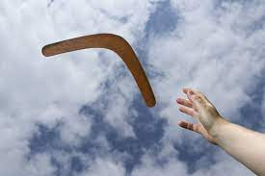
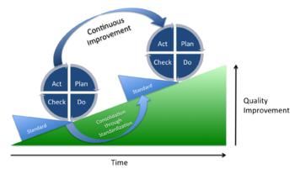
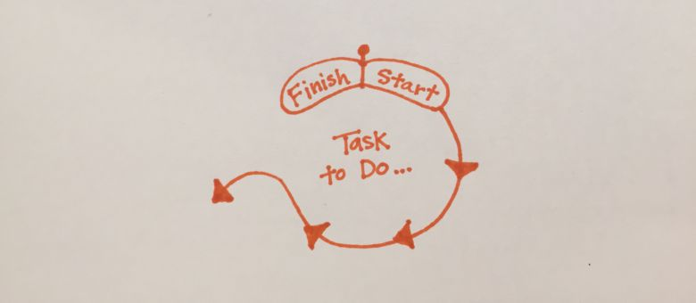
SQAS Risk management general

Slide 5
Starting point in the SQAS questionnaire
Chapter 2 SQAS 2019 and 2022
Risk Management
2.1 Risk assessment and mitigation measures
2.2 Safety
2.3 Health
2.4 Security
2.5 Fair business practices
2.6 Environment
This is not all, there are specific detailed chapters including
items that reflect specific risks

Slide 6
Boomerang
Risk relates to more chapters f.i
  TS chapter 6 Sub contractor management the performance checks
    Confidentiality of data
    Drugs and alcohol policy
    Selection of cleaning stations
    Statuary maintenance
    Training
  Same principle in all other chapters
  TS chapter 7 Equipment
  TS chapter 8 BBS
  TS chapter 9 management of GHG(green House gases)
  TS chapter 10 Security
  TS chapter 11 control of operations
  TS chapter 12 Specific types of transport services and their activities
  TS chapter 13 site inspection
  TS chapter 14 Handling practices of Food…..

Slide 7
Close the loop
Recommendations:
Read the questionnaire
understanding the principles achieving a safe work environment and acceptable quality standard, this by controlling/mitigating the risks.
Strive for continuous improvement
The chapters 6-14 reflect the risk in the specific area which when having under control will lead to a full score in chapter 2.
Score is not the objective it is about showing risks are under control

Slide 8
Pitfalls
Pitfall /ˈpɪtfɔːl/ - noun
1.
a hidden or unsuspected danger or difficulty.
"the pitfalls of buying goods at public auctions"
Linked to:
Hazard / danger / risk / peril / difficulty / issue / problem / catch / snag / stumbling block / drawback / banana skin
2.
a covered pit for use as a trap.
Remember the previous slide:
Read the questionnaire (and understand the interaction between questions)
One question can be linked to other questions
You may first score positively on one question, but the original positive answer may be changed later into a negative answer during the assessment!

Slide 9
Pitfalls
One question can be linked to other questions: An Example
2.1.1. | Is there a process to assess and document the Safety, Health, Environmental, Security risks and working conditions, related to all activities of the company, considering following aspects?

Slide 10

ECTA
Responsible Care
Training Workshop
Risk Assessment in SQAS
Jaap van Welij (Hoyer), Renate Fassbender (TALKE)
Brussels Airport, 07. October 2021

Slide 11
TALKE International
  Global supply chain partner of the chemical and petrochemical industries
  Key Figures
  Key Industries
  Strategic Focus
  73
  years in service
  > € 348
  mio. revenue p.a.
  > 4,600
  employees
  HSSEQ
  Holistic safety and quality as per international standards
  Transport
  Bulk and packed product, all modes
  72
  sites
  > 2,600
  transport units
  ~ 27,200
  products
  chemicals
  Logistics – on site & off site
  Warehouse management and operations, VAS
  Geographical Footprint
  Solution Consultancy & Design
  Analysis, optimisation, EPC, technical expertise
  petrochemicals
  Human Capital Management
  Safety, quality, health, talent, succession
  Integrated SAP IT
  Powerful, resilient, future-proof
  Life sciences

Slide 12
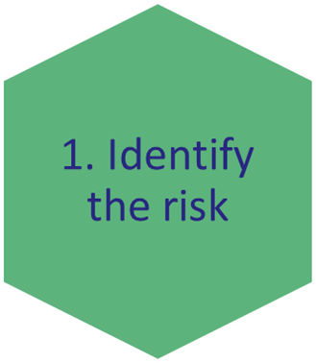
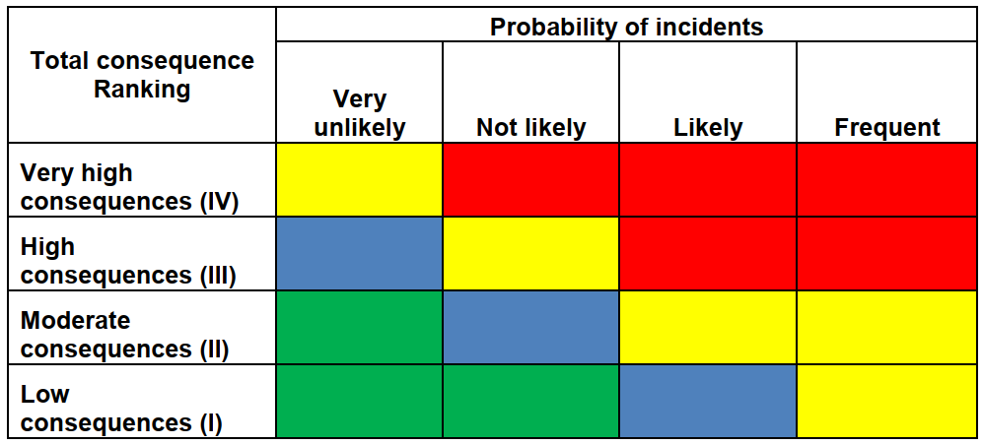
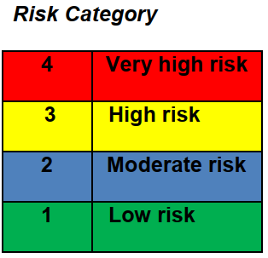
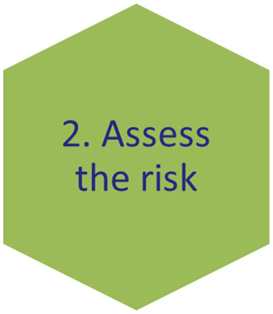
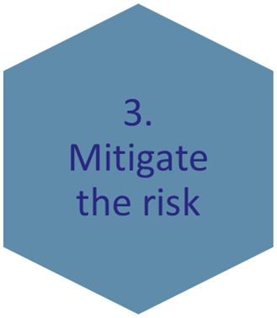
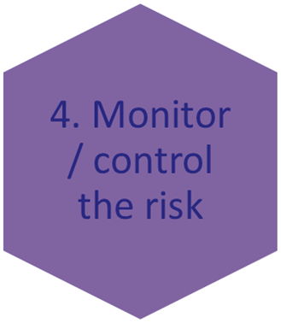
Characteristics: Risk Management
What can go wrong?
How will it affect the organisation?
What can be done?
>> e.g. work environment, business operations, legal liability,
health, environmental protection, property & assests
Risk Matrix: Likelihood & impact of potential risks/severity
Develope a plan to reduce highest-ranked risks
Prevent or reduce undesired effects
I
L
Follow- up on both: the risk & the overall plan to continuously monitor and track new and existing risks

Slide 13
Characteristics: Risk Management
I
L

Slide 14
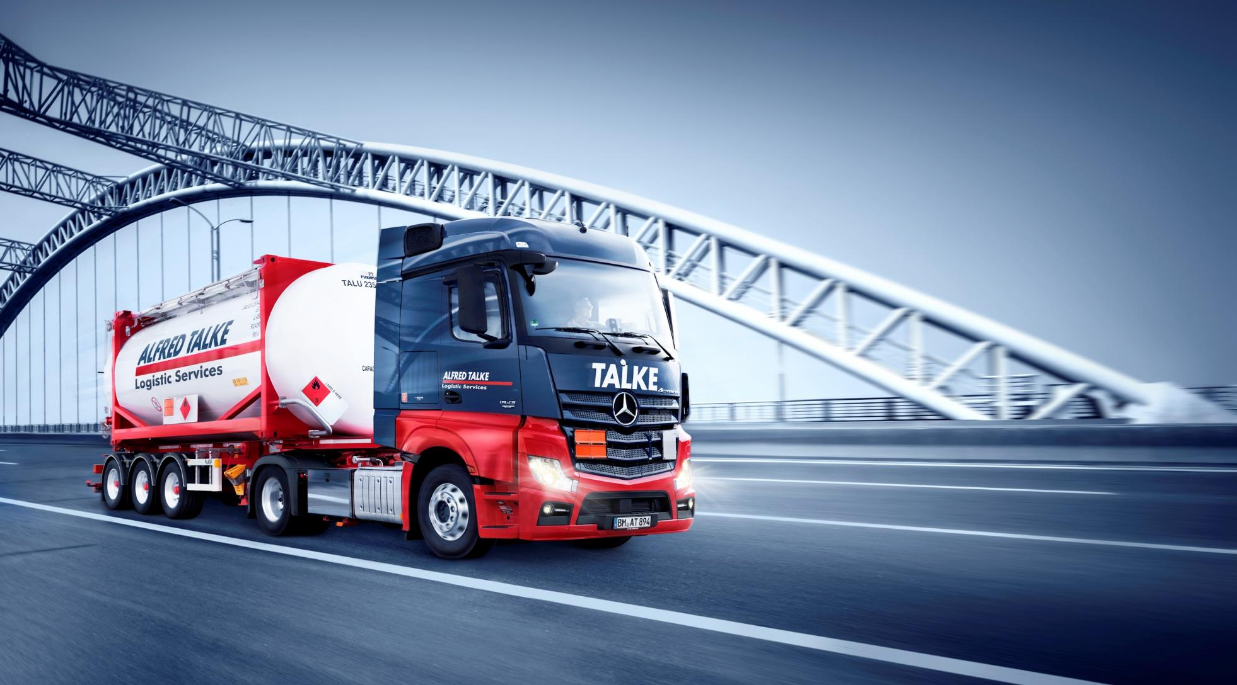
Thank you
For your
attention

