Slide 1
Emission Questions in SQAS 2022
A training example. The days of simplicity are over. | Bernhard Haidacher (LKW Walter) Michael Vetter (Bertschi) Evert de Jong (ECTA)

Slide 2
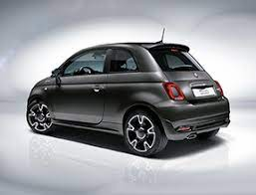
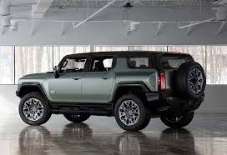
1. introduction
Introduction on Emissions: the choices make the difference

Slide 3
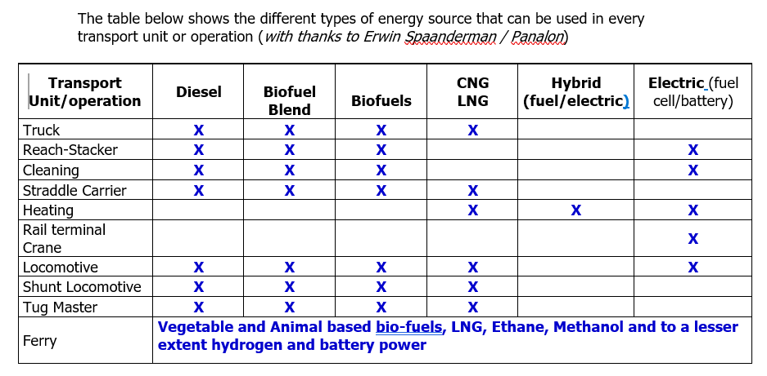
Emissions in SQAS
The Complexity of today’s logistic solutions
And each individual combination has its own emission calculation factor

Slide 4
Emissions in SQAS
The questions in SQAS Transport Service:
Section 9 Measurement and Management of GHG Emissions
Include subjects:
Management decisions
Improvement planning
Training of staff
Knowledge of your equipment/your subcontractors
Your site emissions
Your calculation results linked to your orders (kilometers + tonnages) x emission factors

Slide 5
SQAS Emission questions
You start your approach by:
Management System: define what to do
How about investments; funding the system
Training and Implementation
Check on Progress (Auditing)
Commercial Discussion with your Customers Problem: your competitor is more clever and cheaper in his solutions
Aim of this workshop: Discuss and learn from each other and become more clever and cheaper in your solutions than your competitor!
And please remember:
Not starting now is not an option! Your customers and legislators will enforce progress!

Slide 6
Emissions in SQAS
Management continued:
Baseline is 1990 on CO2 emissions
You need to prepare your company’s path how to reach the goals of “Fit for 55” and 2030 requirements, so
Decide your steps and define a 3 to 5 year improvement plan, including e.g.: - Use of alternative fuels - Alternative modalities - etc.
But stay realistic: - New technology must become wider available at a larger scale - Your investments will impact your rates and your customers must accept these if they are realistic - Nobody expects you to plan yourself into operating losses.

Slide 7
Emissions in SQAS
An example of the contents of a 5 year plan (steps/targets):
Change in fuels
Change in Modality
Change in Empty Returns
Change in Cleaning Requirements
Less just in time orders
Less Customer Loading Window restrictions
Put them all in a spreadsheet and document which choices you make. Then define a timeline showing your targets and how you want to reach them.

Slide 8
Emissions in SQAS
Project Examples:
Customer A: Invest in 2 trucks with electric enginesspecifically to be used for short distance work.
Share investment or linked to a long term contract, covering R.o.I.
Customer B: Project of changed delivery schedules, enabling higher volumes/tonnage to be transported by one transport unit.
Include these projects in your 5 year plan. Promote them on your website.

Slide 9
Emissions in SQAS
So the minimum data you need
And if you have all that,
You need to link these data to the correct emission factors an start calculating.
The easiest option for most LSP’s is to link their Transport Management System to an existing database system which has all data already installed for your use.

Slide 10
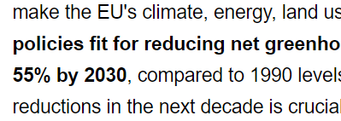
Emission reference sources
For your use we recommend amongst others reference sources and documents:
The SQAS questionnaires themselves
The upcoming Cefic / ECTA Guidelines on Emission Calculation for Chemical Logistics (the revision of our 2011 guideline is underway)
The GLEC Framework and EN 16258
The government requirements for “Fit for 55”
https://ec.europa.eu/commission/presscorner/detail/en/IP_21_3541
+ Re-accreditation training for all current SQAS assessors.

